Slide 1
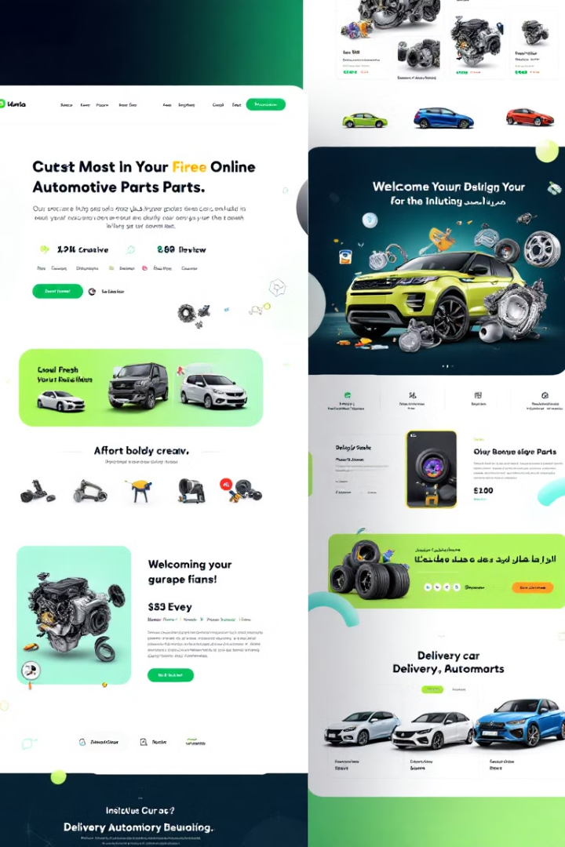
AutoHub Online Platform for Selling, Renting Cars, and Sourcing Spare Parts in Palestine
This presentation outlines the development of AutoHub, a comprehensive online platform designed to revolutionize the Palestinian automotive marketplace, enhancing user experiences and streamlining transactions.
Presented by: Ibrahem Atatri, Mohammad Atteyah, Baseem Al-jaghoub

Slide 2

AutoHub: Online Platform for Selling, Renting Cars, and Sourcing Spare Parts in Palestine
This presentation outlines the development of AutoHub, a comprehensive online platform designed to revolutionize the Palestinian automotive marketplace, enhancing user experiences and streamlining transactions.

Slide 3
Introduction to AutoHub
Streamlined Transactions
Modern Web Platform
The platform aims to save time, reduce exploitation, and enhance user experiences by providing comprehensive services and features.
AutoHub is a modern web platform designed to address inefficiencies in the Palestinian automotive marketplace. It provides a user-friendly interface for buying, renting cars, and sourcing spare parts.

Slide 4

Problem Statement
Lack of a Trusted Marketplace
Inefficiencies and Exploitation
The Palestinian automotive market lacks a reliable digital platform for buying, renting cars, and sourcing spare parts. Existing platforms offer only basic advertising, lacking comprehensive services.
Transactions are often time-consuming and fraught with inefficiencies, leaving users vulnerable to exploitation due to a lack of transparency and reliable information.

Slide 5

Objectives
User-Friendly Platform
Cross-Compatibility Database
Import Service
To create a user-friendly platform for buying, renting cars, and sourcing spare parts, facilitating seamless transactions.
To offer an import service for unavailable parts, ensuring users can access a wide range of options and address their specific needs.
To develop a comprehensive database for spare parts, incorporating cross-compatibility features to ensure users can find the correct parts for their vehicles.

Slide 6
Project Scope
Out of Scope
Included Features
Physical inventory management
Car sales and rentals
Manufacturing or delivery services
Spare parts database with cross-compatibility
Legal dispute management
Import service for unavailable parts
AI-powered smart search
Dealer dashboard for managing listings

Slide 7




Stakeholder Identification
Car Owners
Car Dealers
Individuals seeking to buy or rent cars, as well as source spare parts for their vehicles.
Dealerships offering car sales and rentals, with the ability to manage their listings on the platform.
Repair Workshops
Auto repair shops sourcing spare parts for vehicle repairs, accessing comprehensive information and ordering services.

Slide 8
Functional Requirements
1
User Registration and Sign-in
Secure and user-friendly registration and sign-in processes for all user types, ensuring secure access to the platform.
2
Car Listings and Spare Parts Database
Comprehensive listings for cars and spare parts, enabling users to easily browse and compare options.
3
Cross-Compatibility Feature
An advanced feature that allows users to search for compatible spare parts based on their vehicle make and model.
4
Import Service and Smart Search
A service that facilitates the import of unavailable spare parts, combined with AI-powered smart search for efficient part discovery.
5
Dealer Dashboard and Payment System
A dedicated dashboard for dealers to manage listings, orders, and transactions, integrated with secure payment gateways.
6
User Reviews and Ratings
A system for users to leave reviews and ratings on car listings and spare parts, enhancing trust and transparency.

Slide 9






Non-Functional Requirements
Performance
Fast search results within 2 seconds, ensuring a seamless user experience and efficient data retrieval.
Scalability
The platform should be able to support up to 10,000 concurrent users, ensuring efficient operation and handling of peak user activity.
Reliability
A 99.9% uptime target, ensuring continuous availability and minimal downtime for user access.
Security
Data protection using SSL/TLS encryption, ensuring secure data transmission and user privacy.
Usability
An intuitive user interface, designed to be accessible and easy to navigate for all users, regardless of technical proficiency.
Compatibility
Cross-browser and device compatibility, ensuring access from various platforms and devices.

Slide 10





Constraints
Budget
1
Limited budget of $82,500 for development, hosting, and marketing, requiring efficient resource allocation.
2
Time
A 6-month launch deadline, demanding efficient project management and swift development.
3
Technical
Integration with local payment gateways, requiring technical expertise and compatibility considerations.
Legal
4
Compliance with Palestinian commercial laws, requiring legal counsel and adherence to regulations.
Resource
5
A 7-member development team, necessitating efficient collaboration and prioritization of tasks.

Slide 11
Feasibility Study
Executive Summary
1
AutoHub is a technically and economically viable project, addressing a significant gap in the Palestinian automotive market.
Market Study
2
The target audience includes car owners, dealers, and repair workshops, with limited competition offering comprehensive services.
Financial Analysis
3
Projected revenue streams from user subscriptions, commission fees, and advertising, indicating potential for profitability.

Slide 12
Project Overview
Target Audience
Market Need
Our primary target audience includes individuals seeking to buy, sell, or rent cars, as well as businesses involved in automotive sales, spare parts, and repairs.
Palestine lacks a centralized platform for car-related transactions, making it challenging to find reliable sellers, rent vehicles, or source spare parts. AutoHub aims to bridge this gap.

Slide 13
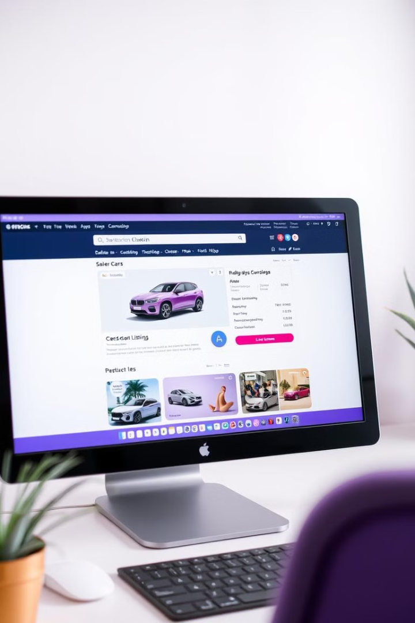
Key Features
Car Listings
Spare Parts Search
Users can browse a comprehensive selection of cars for sale or rent, including details like year, mileage, price, and photos.
A powerful search engine allows users to find the specific spare parts they need, ensuring compatibility with their vehicles.
Dealer Dashboard
Dealers can manage their listings, track inventory, and monitor sales and customer interactions through a dedicated dashboard.

Slide 14
Technical Architecture
Database
Backend
Frontend
PostgreSQL provides a robust and reliable database system for storing and managing all platform data, ensuring data integrity.
Node.js powers the server-side logic, handling data processing, user authentication, and API requests.
React.js is used for building a dynamic and responsive user interface, ensuring a smooth and intuitive experience for users.

Slide 15




Third-Party Integrations
Payment Gateway
Email/SMS
AutoHub integrates with reputable payment gateways like PayPal and Stripe, facilitating secure online transactions.
Integrated email and SMS services provide timely notifications for order confirmations, payment updates, and important announcements.
Shipping and Logistics
AutoHub leverages established logistics providers to ensure efficient and reliable delivery of spare parts across Palestine.

Slide 16
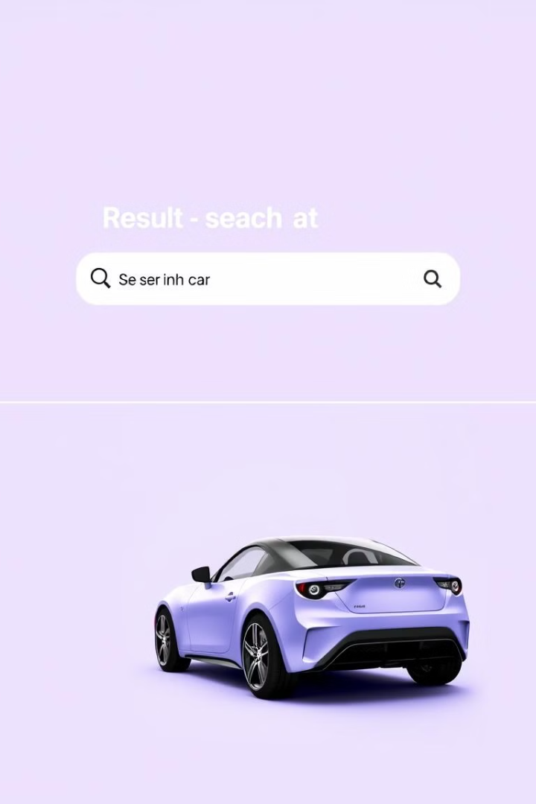



User Stories
As a car buyer, I want to easily search for cars based on specific criteria
The platform allows users to filter cars by brand, model, year, mileage, price range, and other relevant factors.
As a dealer, I want to create and manage my car listings efficiently
Dealers can upload photos, provide detailed descriptions, and update pricing and availability for their listings.
As a user, I want to receive notifications about order updates and payments
Users receive timely email and SMS notifications to stay informed about the status of their transactions.

Slide 17



Future Plans
1
Mobile App Development
2
Expand to Other Palestinian Cities
3
Integrate AI-powered Car Valuation
Our future plans include developing a mobile app for enhanced user convenience, expanding AutoHub to other Palestinian cities, and incorporating AI-powered car valuation for more accurate pricing.

Slide 18

Call to Action
1
2
Invest in Our Future
Partner with Us
Join us in revolutionizing the automotive industry in Palestine.
Collaborate with AutoHub to create a thriving automotive ecosystem.
3
Support Our Vision
Be a part of our journey to connect buyers, sellers, and dealers.

Slide 19
Version Control and Documentation
Documentation
Git Workflow
Comprehensive documentation is essential for maintaining a transparent and maintainable project. We use a CHANGELOG.md file to track all updates, providing a detailed record of changes made throughout the development process. CHANGELOG.md
We utilize a robust Git workflow to ensure efficient collaboration and code management. The main branch houses stable code, while feature branches are dedicated to developing new features. Pull requests facilitate code review before merging changes into the main branch.

Slide 20
Software Modules
User Management
Car Management
Smart Search
Securely manages user accounts, profiles, permissions, and interactions with the platform.
Provides comprehensive features for listing, searching, managing, and showcasing vehicles.
Employs AI-powered search algorithms to facilitate accurate and efficient vehicle discovery.
Spare Parts Management
Payment
Notification
Offers a dedicated module for listing, searching, and sourcing spare parts.
Integrates secure payment gateways for seamless transaction processing.
Delivers timely and relevant notifications to users, keeping them informed about updates, activities, and important information.
Dashboard
Provides a user-friendly dashboard for both buyers and sellers, offering personalized insights and analytics.

Slide 21
Deployment Strategy
CI/CD Pipeline
Environment Setup
To automate the deployment process and maintain consistency, we implement a robust CI/CD pipeline using tools like GitHub Actions or Jenkins. This pipeline streamlines the development cycle, allowing for continuous integration and automated deployment of code changes into the production environment.
We leverage cloud-based infrastructure to ensure scalability, security, and high availability. We utilize a cloud provider like AWS, Google Cloud, or Azure, combined with a robust database like PostgreSQL, and configure the web server (Nginx or Apache). Both backend and frontend components are carefully set up for seamless integration and optimized performance.

Slide 22
Project Management
Initiation
1
Define project scope, gather requirements, and establish a clear project charter.
2
Planning
Develop a detailed work breakdown structure, define tasks, allocate resources, and establish timelines.
Implementation
3
Execute the project plan, develop software components, and implement functionalities.
4
Monitoring & Controlling
Track progress, monitor performance, manage risks, and ensure adherence to project plans.
Closing
5
Finalize the project, document lessons learned, and obtain formal acceptance from stakeholders.

Slide 23





Roles and Responsibilities
Project Manager
Business Lead
Software Engineer
Frontend Developer
Mohammad Atteyah
Baseem Al-jaghoob
Ibrahem Atatri
Ya’qoob
Backend Developer
AI Specialist
Ahmad
Jameel

Slide 24
Conclusion and Future Steps
1
Key Achievements
2
Impact
3
Future Steps
AutoHub represents a significant step forward in the Palestinian automotive market. The platform's advanced features, robust architecture, and user-centric design will revolutionize the way cars are bought, sold, rented, and maintained in Palestine. The project's success will foster greater efficiency, economic growth, and digital adoption within the automotive sector.
Moving forward, AutoHub will prioritize continuous improvement, building stronger supplier networks, and implementing robust digital marketing strategies to maximize reach and impact.

